Slide 1
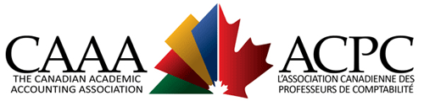



How Robust are the Foundations of the Conceptual Framework?
Sudipta Basu
Monday, August 12, 2019

Slide 2
A brief tribute to Sensei Yuji Ijiri
I was never officially a student or colleague
Missed a chance in 2004 Emory summer class
But tried to sit next to him at CMU conferences
Quiet, gentle, kind, and thoughtful
A giant of accounting inquiry
Whose shoulders I have always stood on
But never quite seeing as far as he did ☹
Notes:
Anscombe, 1973 The American Statistician. I use this example in my 2015 Journal of International Accounting Research.

Slide 3
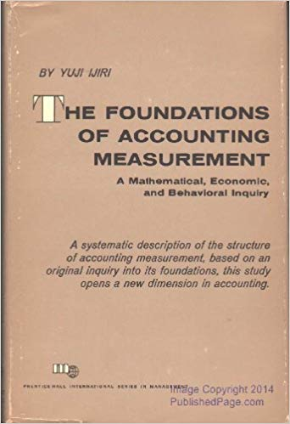
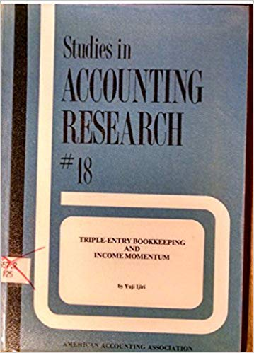
Ijiri wrote a lot on conceptual issues

Slide 4
A couple of Ijiri’s conceptual papers
Generalizations of Cost-or-Market Valuation
Yuji Ijiri and Isao Nakano, 1989 Acc Horizons
On the accountability-based conceptual framework of accounting
Yuji Ijiri, 1983 JAPP

Slide 5
A few disclaimers
I am employed at Temple University but my views may not be shared by my colleagues, students, staff, family, friends, or anyone else
Very broad historical sketch with few details
Hindsight is 20-20. I would have done no better (likely worse) if I were a standard-setter when the Conceptual Frameworks were started

Slide 6
An overarching question(s)
Why do so many (reputed) accounting academics find fault with the Boards’ Conceptual Frameworks?
e.g. Demski (2007 AH) “irreparably flawed”
Why are standard-setters surprised (even shocked) by these criticisms?
What causes the gulf in perspectives?

Slide 7
Theoretically, what is accounting for?
SEC/IOSCO: Protect investors, maintain fair, orderly and efficient markets; and facilitate capital formation (i.e. a Single-purpose tool to fulfill legislated purposes of agency creation)
Academics: Broader view of general-purpose financial statements—a General-purpose tool to help entrepreneurship, taxation, contracting, dispute resolution, stewardship, valuation…
e.g. Dopuch and Sunder (1980 TAR) on SFAC 1, 2
Ijiri (1983 JAPP), Ball (1989), Sunder (1997) CFs

Slide 8

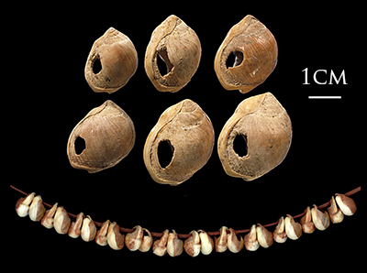
Prehistorically, what is accounting for?
Recordkeeping (100,000 BC? to 3,000 BC)
Memory, ownership, dispute resolution, taxation

Slide 9
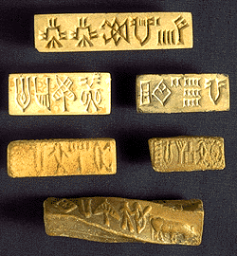
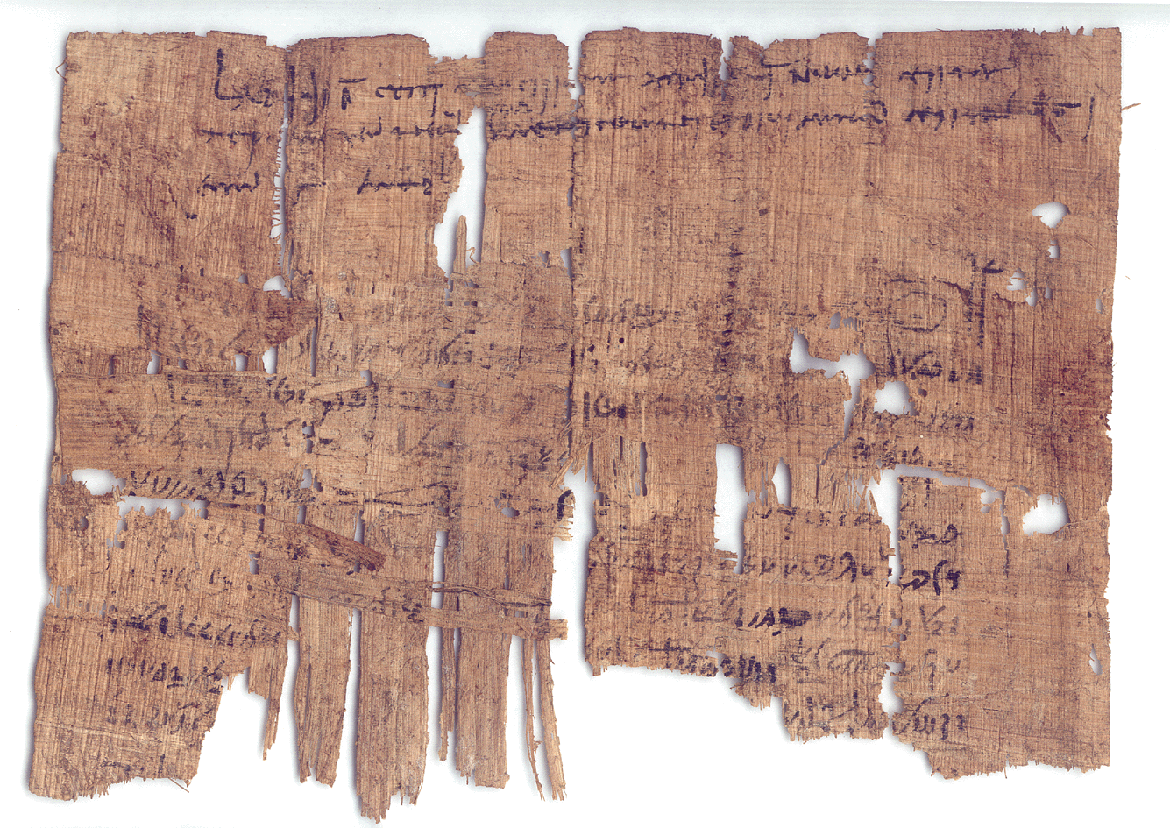
Historically, what is accounting for?
Single-entry Bookkeeping (3,000 BC to 1,300 AD)
Contracting, organization formation, stewardship

Slide 10

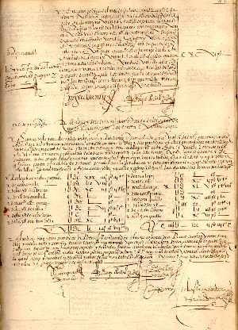
Historically, what is accounting for?
Double-entry Bookkeeping (1,300 to 1,900)
Transaction analysis, external finance, valuation

Slide 11
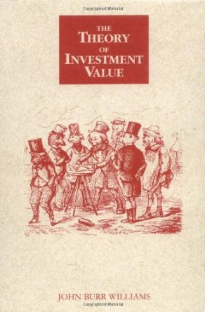

Recently, what is accounting for?
Accounting (1,900 to present)
Financial intermediation, rate-setting regulation

Slide 12
Why Accounting Conceptual Frameworks?
Push to make business schools “scientific” starting in mid-1950s with lots of funding
Academics sought state-of-the-art “axioms” from prestigious business school departments:
Decision Usefulness (from Decision Science)
Efficient Markets (from Asset Pricing)
Modigliani-Miller Theorems (Corporate Finance)
ASOBAT (1967), APB 4 (1970), Trueblood (1973)

Slide 13
Decision usefulness is two-edged sword
Quick link to user objective/utility function
But what if user objectives differ?
Arrow theorem implies no best answer
Boards focus on investor needs to sidestep
Ravencroft & Williams (2014 CAR)…
Create fictitious users (Young, 2006 AOS)

Slide 14
Margaret Atwood:
Novelists, Margaret Atwood once said, spend their time imagining that nonexistent people are real. Bureaucrats, she continued, do the reverse: As they construct rules and procedures to make normal life impossible, they pass their days imagining that real people don’t exist.
(Andrew Stark, WSJ, 7/30/19)
Lawyers and financial engineers structure transactions to exploit the rules (Herz, 2013; Dye, Glover & Sunder, 2015 AH)

Slide 15
Efficient market hypothesis
In perfect markets, price is always right
Properly anticipated price follows random walk (Mandelbrot 1966, Samuelson 1969 IER)
Price incorporates news quickly & unbiasedly
FFJF (1969 IER), Beaver (1968 JAR)
But Ball & Brown (1968 JAR) found PEAD
If markets freeze up, fair values not optimal?

Slide 16
Modigliani-Miller theorems assume:
Perfect markets and certainty, which means:
Costless memory
Costless information
Costless transacting and contract enforcement
No bankruptcy
No taxation or regulation…
No agency costs, etc…
NO DECISION ERRORS

Slide 17
Modigliani & Miller assumptions useful
A few influential models in M&M world:
Black-Scholes option pricing
Feltham-Ohlson residual income
…
But MM assumptions also constrain…

Slide 18
Corporate finance vs. Standard setters
Over the last 50 years:
Corporate finance has challenged the M&M assumptions and improved the fit between theory and practice
Standard-setters have stayed in M&M world, where accounting has no impact (because useless) and are surprised when accounting academics (e.g. positive accounting theorists, critical theorists) question their conclusions

Slide 19
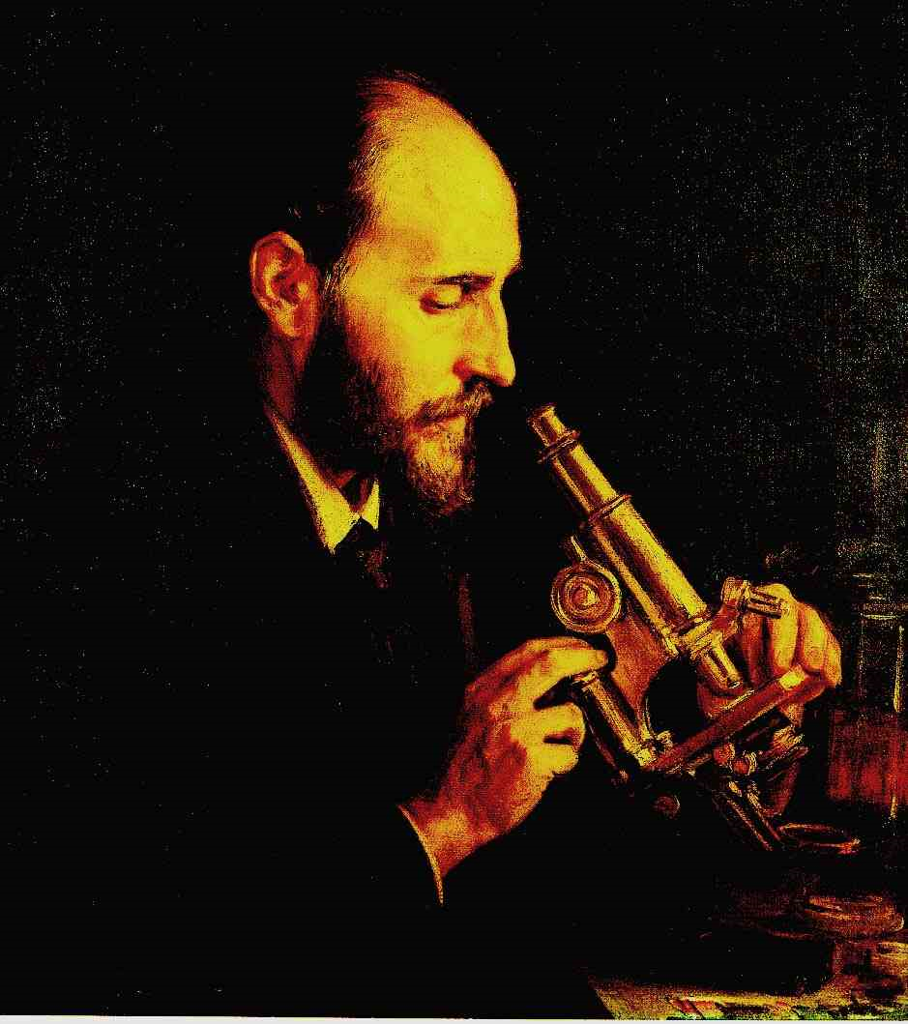
“In politics, the worship of inflexibility or resistance to change is considered a virtue, whereas in science it is almost always an unmistakable sign of pride or shortsightedness”(p. 124)
Advice to a young investigator
Santiago Ramon y Cajal

Slide 20
G.K. Chesterton (1929 The Thing)
In the matter of reforming things, as distinct from deforming them, there is one plain and simple principle; a principle which will probably be called a paradox. There exists in such a case a certain institution or law; let us say, for the sake of simplicity, a fence or gate erected across a road. The more modern type of reformer goes gaily up to it and says, “I don’t see the use of this; let us clear it away.” To which the more intelligent type of reformer will do well to answer: “If you don’t see the use of it, I certainly won’t let you clear it away. Go away and think. Then, when you can come back and tell me that you do see the use of it, I may allow you to destroy it.

Slide 21
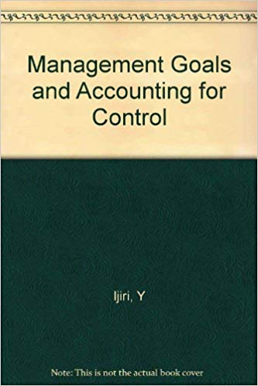
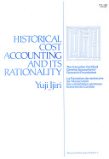
Standard setters ignore alternative perspectives

Slide 22
How would challenging M&M help?
Risk and uncertainty issues raise fundamental issues about what people want/can do:
Maximization vs. survival/satisfaction
Optimal solutions vs. robust heuristics
Quadratic risk vs. hazard (tail) risk
Expected value vs. median (other) value
or combination value (e.g. LCM)

Slide 23
How would challenging M&M help?
Costly “hard” memory helps explain:
Emergence & existence of accounting
Importance of seals, receipts & contracts
Accounting use in dispute resolution
Permanent records and archives in courts
Deferral (NOT accrual) accounting
Cross-linking of DEB records

Slide 24
How would challenging M&M help?
Costly information helps explain:
Use of transaction prices (historical cost)
Existence of
cost and managerial accounting
information intermediaries
Late emergence of income statement
Recognition vs disclosure
Presentation format mattering

Slide 25
How would challenging M&M help?
Positive transaction costs explain:
Existence of (because of accounting in):
firms (Coase 1937 Economica)
markets (Coase 1937 Economica)
government (Coase 1960 JLE)
Emergence and use of money in trade
Long-term contracts
Ball (1989) conceptual framework

Slide 26
How would challenging M&M help?
Agency costs (and data manipulation) explain:
Accounting use in incentive contracts
Asymmetric verification via:
Conditional conservatism
External auditing
Internal auditing
Ijiri (1983 JAPP), Sunder (1997), etc.

Slide 27
How would challenging M&M help?
Bankruptcy (avoidance) explains:
Use of accounting in debt contracts
Accounting methods:
Successful efforts (O&G)
Expensing of R&D (liquidation value 0)
Frozen GAAP (contracting out of GAAP)

Slide 28
How would challenging M&M help?
Taxation and regulation explain:
Multiple sets of books (medieval, U.S.)
Lobbying of standard setters & Congress
Income tax-reducing accounting rules:
(Accelerated) depreciation
LIFO
Pooling-of-interests (in rate-setting)

Slide 29
But how does this help standard-setters?
Does not help set better standards today
But can explain standard failures better
And could lead to realistic future standards
More importantly, a knowledge-based Conceptual Framework helps academics include RESEARCH in textbooks, TEACH better and bring back Accounting Theory courses

Slide 30
Closing sentiments
“We thus have cause to feel grateful to the drafters of recommendations; and this review should on no account be construed as an attack on them. Obviously, they have devoted much time and care to their task, and have been prompted by a high sense of public service. If harm should in the end come from their work, the blame should attach more to disciples who have accepted their teaching too eagerly, and have invested it with an ex cathedra quality that could not perhaps have been foreseen.” (Baxter 1962, 419-420)

